Slide 1
Lecture 12
Bellman-Ford, Floyd-Warshall, and Dynamic Programming!

Slide 2
Last time
Dijkstra’s algorithm!
Solves single-source shortest path in weighted graphs.

Slide 3
Today
Bellman-Ford algorithm
Another single-source shortest path algorithm
This is an example of dynamic programming
We’ll see what that means
Floyd-Warshall algorithm
An “all-pairs” shortest path algorithm
Another example of dynamic programming

Slide 4
Recall
Weights on edges represent costs.
The cost of a path is the sum of the weights along that path.
A shortest path from s to t is a directed path from s to t with the smallest cost.
The single-source shortest path problem is to find the shortest path from s to v for all v in the graph.
A weighted graph:
u
s
3
32
1
5
1
This is a path from s to t of cost 22.
b
v
13
a
21
2
16
t
This is a path from s to t of cost 10. It is the shortest path from s to t.

Slide 5
One drawback to Dijkstra
Doesn’t work with negative edge weights
u
s
3
32
-1
5
-1
b
v
13
Why would we ever have negative weights?
Negative costs might mean benefits.
eg, it costs me -$2 when I get $2.
a
21
-2
16
t

Slide 6
Bellman-Ford algorithm
Slower (but arguably simpler) than Dijkstra’s algorithm.
Works with negative edge weights.

Slide 7





Bellman-Ford Algorithm
*We won’t actually store all these, but let’s pretend we do for now.
We keep* an array d^{(k)} of length n for each k = 0, 1, …, n-1.
Formally, we will maintain the loop invariant:
d^{(k)}[a] is the cost of the shortest path from s to a with at most k edges in it.
s u v t
d⁽⁰⁾
0
$$∞$$
$$∞$$
$$∞$$
0
s
s u v t
2
$$∞$$
d⁽¹⁾
u
1
s u v t
5
d⁽²⁾
2
t
s u v t
v
d⁽³⁾
$$∞$$
-2
$$∞$$

Slide 8
Now update!
While maintaining:
d^{(k)}[a] is the cost of the shortest path from s to a with at most k edges in it.
We will use the table d⁽⁰⁾ to fill in d⁽¹⁾
Then use d⁽¹⁾ to fill in d⁽²⁾
…
Then use d^{(k-1)} to fill in d^{(k)}
...
Then use d^{(n-2)} to fill in d^{(n-1)}
This eventually gives us what we want:
d^{(k)}[a] is the shortest path from s to a with at most k edges.
Eventually we’ll get all the shortest paths…

Slide 9
How do we get d^{(k)}[b] from d^{(k-1)}?
Want to maintain:
d^{(k)}[a] is the cost of the shortest path from s to a with at most k edges in it.
Two cases:
Case 1: the shortest path from s to b with at most k edges actually has at most k-1 edges.
d^{(k)}[b] = d^{(k-1)}[b]
s
2
b
2
u
say k=3
Case 2: the shortest path from s to b with at most k edges really has k edges.
d^{(k)}[b] = d^{(k-1)}[a] + w(a,b) for some a...
x
2
a
2
d^{(k)}[b] = min_{a} {d^{(k-1)}[a] + w(a,b)}
2
s
10
b
2
u
say k=3

Slide 10
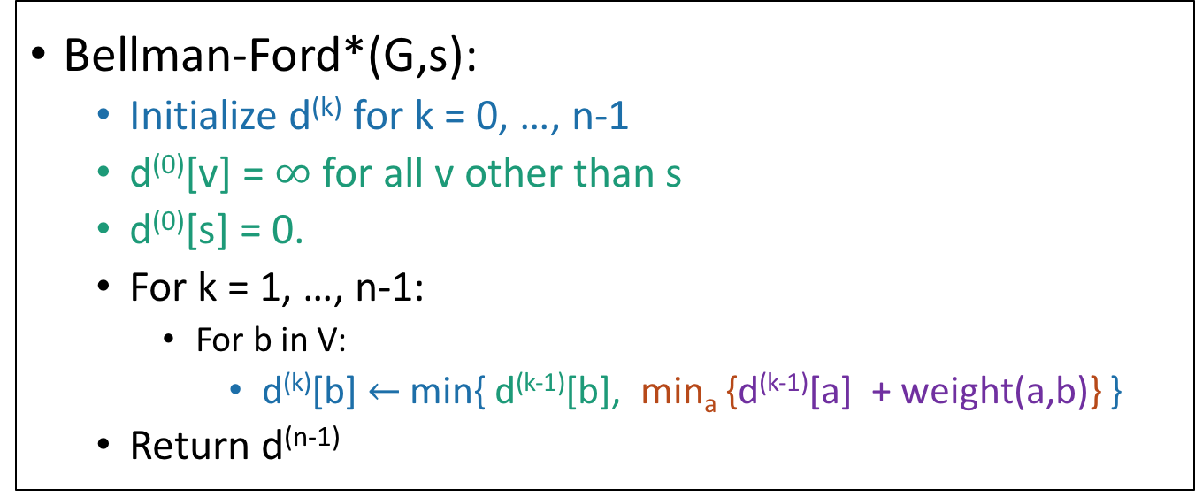
Bellman-Ford Algorithm*
Bellman-Ford*(G,s):
Initialize d^{(k)} for k = 0, …, n-1
d⁽⁰⁾[v] = $∞$ for all v other than s
d⁽⁰⁾[s] = 0.
For k = 1, …, n-1:
For b in V:
d^{(k)}[b] $←$ min{ d^{(k-1)}[b], min_{a} {d^{(k-1)}[a] + weight(a,b)} }
Return d^{(n-1)}
Case 1
Case 2
If we set d^{(k)}[b] to be the minimum of the previous two cases, then we maintain the loop invariant that:
d^{(k)}[a] is the cost of the shortest path from s to a with at most k edges in it.

Slide 11

Bellman-Ford Algorithm* Example
d^{(k)}[a] is the cost of the shortest path from s to a with at most k edges in it.
For k = 1,…,n-1:
For b in V:
d^{(k)}[b] $←$ min{ d^{(k-1)}[b], min_{a} {d^{(k-1)}[a] + weight(a,b)} }
s u v t
d⁽⁰⁾
0
$$∞$$
$$∞$$
$$∞$$
0
s
s u v t
2
$$∞$$
d⁽¹⁾
u
1
s u v t
5
d⁽²⁾
2
t
s u v t
v
d⁽³⁾
$$∞$$
-2
$$∞$$

Slide 12



Bellman-Ford Algorithm* Example
d^{(k)}[a] is the cost of the shortest path from s to a with at most k edges in it.
For k = 1,…,n-1:
For b in V:
d^{(k)}[b] $←$ min{ d^{(k-1)}[b], min_{a} {d^{(k-1)}[a] + weight(a,b)} }
s u v t
d⁽⁰⁾
0
$$∞$$
$$∞$$
$$∞$$
0
s
s u v t
2
$$2$$
d⁽¹⁾
0
2
5
$$∞$$
u
1
s u v t
5
d⁽²⁾
2
t
s u v t
v
d⁽³⁾
$$∞$$
-2
$$5$$

Slide 13



Bellman-Ford Algorithm* Example
d^{(k)}[a] is the cost of the shortest path from s to a with at most k edges in it.
For k = 1,…,n-1:
For b in V:
d^{(k)}[b] $←$ min{ d^{(k-1)}[b], min_{a} {d^{(k-1)}[a] + weight(a,b)} }
s u v t
d⁽⁰⁾
0
$$∞$$
$$∞$$
$$∞$$
0
s
s u v t
2
$$2$$
d⁽¹⁾
0
2
5
$$∞$$
u
1
s u v t
5
d⁽²⁾
0
2
4
3
2
t
s u v t
v
d⁽³⁾
$$3$$
-2
$$4$$

Slide 14


Bellman-Ford Algorithm* Example
d^{(k)}[a] is the cost of the shortest path from s to a with at most k edges in it.
For k = 1,…,n-1:
For b in V:
d^{(k)}[b] $←$ min{ d^{(k-1)}[b], min_{a} {d^{(k-1)}[a] + weight(a,b)} }
s u v t
d⁽⁰⁾
0
$$∞$$
$$∞$$
$$∞$$
0
s
s u v t
2
$$2$$
d⁽¹⁾
0
2
5
$$∞$$
u
1
s u v t
5
d⁽²⁾
0
2
4
3
2
t
s u v t
v
d⁽³⁾
$$2$$
-2
$$4$$
0
2
4
2

Slide 15
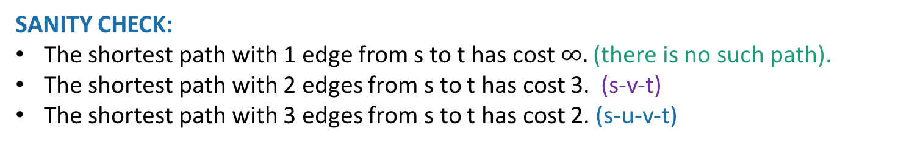

Bellman-Ford Algorithm* Example
d^{(k)}[a] is the cost of the shortest path from s to a with at most k edges in it.
SANITY CHECK:
The shortest path with 1 edge from s to t has cost $∞.$ (there is no such path).
The shortest path with 2 edges from s to t has cost 3. (s-v-t)
The shortest path with 3 edges from s to t has cost 2. (s-u-v-t)
And this one is the shortest path!!!
s u v t
d⁽⁰⁾
0
$$∞$$
$$∞$$
$$∞$$
0
s
s u v t
2
$$2$$
d⁽¹⁾
0
2
5
$$∞$$
u
1
s u v t
5
d⁽²⁾
0
2
4
3
2
t
s u v t
v
d⁽³⁾
$$2$$
-2
$$4$$
0
2
4
2

Slide 16
How do we actually implement this? (This is what the * on all the previous slides was for).
Don’t actually keep all the arrays d^{(k)} around.
Just keep two of them at a time, that’s all we need.
Running time: O(mn)
That’s worse than Dijkstra, but BF can handle negative edge weights.
Space complexity:
We need space to store the graph and two arrays of size n.
*WARNING: This is slightly different from the version of Bellman-Ford in CLRS.
But we will stick with what we just saw for pedagogical reasons.
See Lecture Notes 11.5 (listed on the webpage in the Lecture 12 box) for notes on the analysis of the slightly different CLRS version.

Slide 17
Bellman-Ford Algorithm*
Let’s stick with this version though.
Bellman-Ford*(G,s):
Initialize d^{(k)} for k = 0, …, n-1
d⁽⁰⁾[v] = $∞$ for all v other than s
d⁽⁰⁾[s] = 0.
For k = 1, …, n-1:
For b in V:
d^{(k)}[b] $←$ min{ d^{(k-1)}[b], min_{a} {d^{(k-1)}[a] + weight(a,b)} }
Return d^{(n-1)}

Slide 18
Why does it work?
First, we’ve been asserting that:
Technically, this requires proof!
We’ve basically already seen the proof!
It follows from induction with the inductive hypothesis
d^{(n-1)}[a] is the cost of the shortest path from s to a with at most n-1 edges in it.
d^{(k)}[a] is the cost of the shortest path from s to a with at most k edges in it.
Work out the details of this proof! (On your own, after class). To help you, there’s an outline on the next slide. (Which we’ll skip now).

Slide 19



Sketch of proof [skip this in lecture] that this thing we’ve been asserting is really true
Inductive hypothesis:
Base case:
Inductive step:
Conclusion:
d^{(k)}[a] is the cost of the shortest path from s to a with at most k edges in it.
0
$$∞$$
$$∞$$
$$∞$$
For k = 0:
Case 2: the shortest path from s to b of length at most k edges has exactly k edges
d^{(k)}[b] $←$ min{ d^{(k-1)}[b], min_{a} {d^{(k-1)}[a] + weight(a,b)} }
In either case, we make the correct update.
Case 1: the shortest path from s to be has <k edges
When k = n-1, the inductive hypothesis reads:
d^{(n-1)}[a] is the cost of the shortest path from s to a with at most n-1 edges in it.

Slide 20
Is this the conclusion we want?
d^{(n-1)}[a] is the cost of the shortest path from s to a with at most n-1 edges in it.
We still need to prove that this implies BF* is correct.
We return d^{(n-1)}
Need to show d^{(n-1)}[a] = distance(s,a).
Enough to show:
Shortest path with at most n-1 edges
Shortest path with any number of edges

Slide 21
DANGER!
Shortest path with at most n-1 edges
Shortest path with any number of edges
A negative cycle is a directed cycle with negative total cost
If the graph has a negative cycle, this might not be true.
If there is a negative cycle, there may not be a shortest path between two vertices!
s
2
u
1
-5
2
t
v
-2

Slide 22
But if there is no negative cycle
Then not only are there shortest paths, but actually there’s always a simple shortest path.
A simple path in a graph with n vertices has at most n-1 edges in it.
s
-2
v
10
t
2
-5
x
y
This cycle isn’t helping. Just get rid of it.
3
s
u
“Simple” means that the path has no cycles in it.
t
Can’t add another edge without making a cycle!
v

Slide 23
Let’s go after a new conclusion.
Theorem:
The Bellman-Ford Algorithm* is correct as long as G has no negative cycles.
*We will prove this for our version of Bellman-Ford. See Notes 11.5 or CLRS for CLRS version.

Slide 24
Proof
d^{(n-1)}[a] is the cost of the shortest path from s to a with at most n-1 edges in it.
By induction,
If there are no negative cycles,
The shortest path is WLOG simple, and all simple paths have at most n-1 edges.
So we conclude that our return value d^{(n-1)}[a] is
d^{(n-1)}[a] = the cost of a shortest path from s to a.
Shortest path with at most n-1 edges
Shortest path with any number of edges

Slide 25
So that proves:
Theorem:
The Bellman-Ford Algorithm* is correct as long as G has no negative cycles.
Further, if G has a negative cycle, Bellman-Ford can detect that.
(See Notes 11.5)

Slide 26
What have we learned?
The Bellman-Ford algorithm is slower than Dijkstra:
O(mn) time
But it works with negative edges weights.
You’ll see how Dijkstra does with negative edge weights in HW5.
It doesn’t work with negative cycles, but in that case shortest paths don’t even make sense.

Slide 27
Bellman-Ford is also used in practice.
eg, Routing Information Protocol (RIP) uses something like Bellman-Ford.
Older protocol, not used as much anymore.
Destination | Cost to get there | Send to whom?
172.16.1.0 | 34 | 172.16.1.1
10.20.40.1 | 10 | 192.168.1.2
10.155.120.1 | 9 | 10.13.50.0
Each router keeps a table of distances to every other router.
Periodically we do a Bellman-Ford update.
This also means that if there are changes in the network, this will propagate. (maybe slowly…)
Notes:
In general this is called a “distance-vector” routing protocol which means it maintains a vector of distances. OTOH, the OSPF algorithm that uses Dijkstra is “link-state” routing protocol which means that a node should broadcast to everyone if the topology changes.

Slide 28
This was an example of…
Dynamic
Programming!

Slide 29
What is dynamic programming?
It is an algorithm design paradigm
like divide-and-conquer is an algorithm design paradigm.
Usually it is for solving optimization problems
eg, shortest path

Slide 30
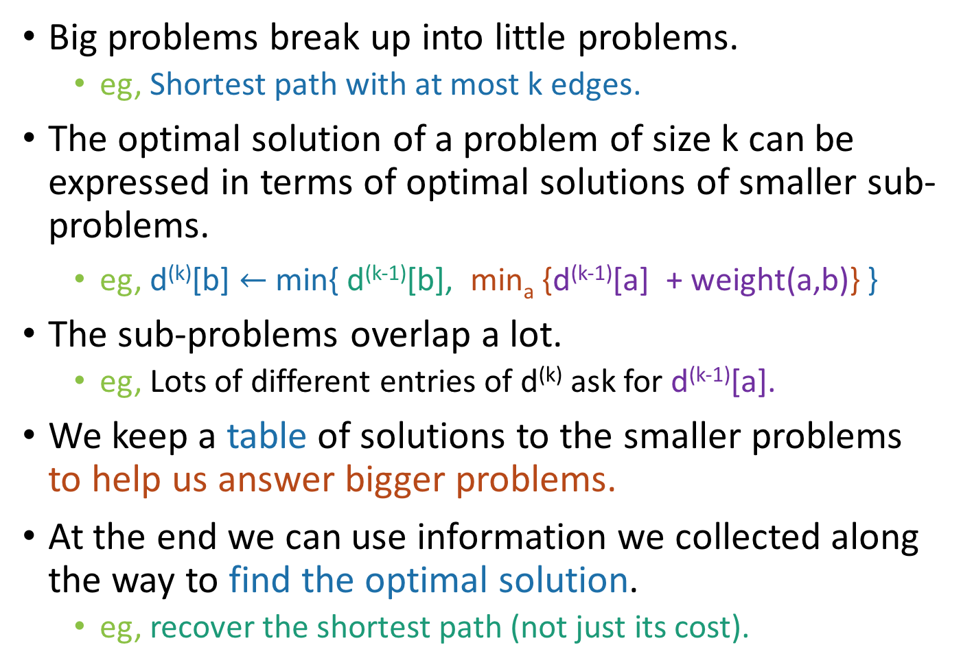
Elements of dynamic programming
Big problems break up into little problems.
eg, Shortest path with at most k edges.
The optimal solution of a problem of size k can be expressed in terms of optimal solutions of smaller sub-problems.
eg, d^{(k)}[b] $←$ min{ d^{(k-1)}[b], min_{a} {d^{(k-1)}[a] + weight(a,b)} }
The sub-problems overlap a lot.
eg, Lots of different entries of d^{(k)} ask for d^{(k-1)}[a].
We keep a table of solutions to the smaller problems to help us answer bigger problems.
At the end we can use information we collected along the way to find the optimal solution.
eg, recover the shortest path (not just its cost).

Slide 31
Two ways to think about and/or implement DP algorithms
Top down
Bottom up
This picture isn’t hugely relevant but I like it.

Slide 32
Bottom up approach
What we just saw.
Solve the small problems first
fill in d⁽⁰⁾
Then bigger problems
fill in d⁽¹⁾
…
Then bigger problems
fill in d^{(n-2)}
Then finally solve the real problem.
fill in d^{(n-1)}

Slide 33
Top down approach
Think of it like a recursive algorithm.
To solve the big problem:
Recurse to solve smaller problems
The difference from divide and conquer:
Memo-ization
Keep track of what small problems you’ve already solved to prevent re-solving the same problem twice.

Slide 34
Example: top-down** version of BF*
The actual pseudocode here isn’t important, I just want to talk about the structure of it.
Bellman-Ford*(G,s):
Initialize a bunch of empty tables d^{(k)} for k=0,…,n-1,
Fill in d⁽⁰⁾
for b in V:
BF*_helper(G, s, b, n-1)
BF*_helper(G, s, b, k):
For each a so that (a,b) in E, and also for b:
If d^{(k-1)}[a] is not already in the table:
d^{(k-1)}[a] = BF*_helper( G, s, a, k-1 )
return min{ d^{(k-1)}[b], min_{a} {d^{(k-1)}[a] + weight(a,b)} }
If we don’t already have d^{(k-1)}[a] stored, compute it.
But store it so that we never have to do that again!
*Not the actual Bellman-Ford algorithm; we don’t want to keep all these tables around
**Probably not the best way to think about Bellman-Ford: this is for DP pedagogy only!

Slide 35
Visualization top-down approach
Identify repeated nodes and don’t do the same work twice!
d^{(n-1)}[u]
d^{(n-1)}[v]
d^{(n-2)}[x]
d^{(n-2)}[y]
d^{(n-2)}[a]
d^{(n-2)}[a]
d^{(n-2)}[x]
This is a really big recursion tree! Naively, n layers, so at least 2^{n} time!
d^{(n-3)}[z]
d^{(n-3)}[t]
d^{(n-3)}[v]
d^{(n-3)}[v]
d^{(n-3)}[x]

Slide 36
Visualization top-down approach
Identify repeated nodes and don’t do the same work twice!
d^{(n-1)}[u]
d^{(n-1)}[v]
d^{(n-2)}[x]
d^{(n-2)}[a]
d^{(n-2)}[z]
d^{(n-2)}[y]
Now it’s a much smaller
“recursion DAG!”
d^{(n-3)}[z]
d^{(n-3)}[t]
d^{(n-3)}[v]
d^{(n-3)}[x]

Slide 37
What have we learned?
Dynamic programming:
Paradigm in algorithm design.
Useful when there’s optimal substructure:
optimal solutions to a big problem break up in to optimal sub-solutions of subproblems.
Useful when these subproblems overlap a lot:
Use memo-ization (aka, put it in a table) to prevent repeated work.
Can be implemented bottom-up or top-down.
It’s a fancy name for a pretty common-sense idea:
Don’t duplicate work if you don’t have to!

Slide 38
Why “dynamic programming” ?
Programming refers to finding the optimal “program.”
as in, a shortest route is a plan aka a program.
Dynamic refers to the fact that it’s multi-stage.
But also it’s just a fancy-sounding name.
Manipulating computer code in an action movie?

Slide 39
Why “dynamic programming” ?
Richard Bellman invented the name in the 1950’s.
At the time, he was working for the RAND Corporation, which was basically working for the Air Force, and government projects needed flashy names to get funded.
From Bellman’s autobiography:
“It’s impossible to use the word, dynamic, in the pejorative sense…I thought dynamic programming was a good name. It was something not even a Congressman could object to.”

Slide 40
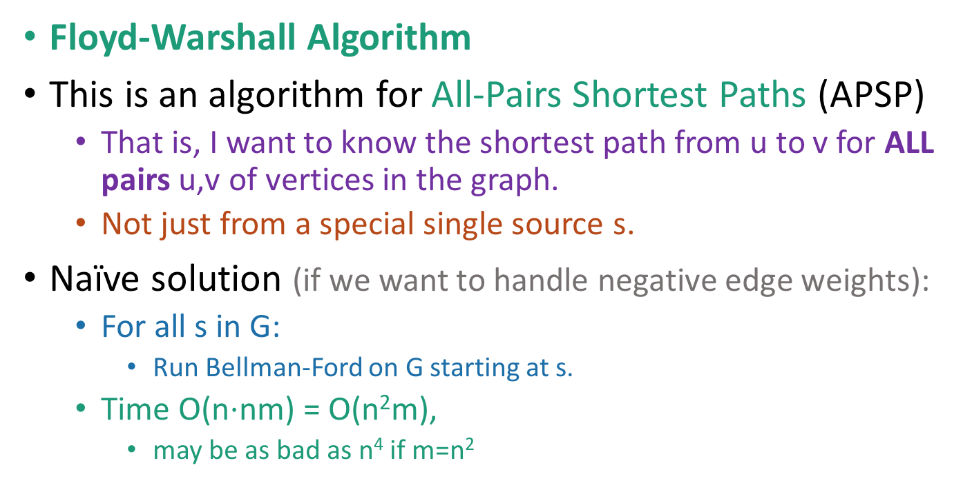
Another example
Floyd-Warshall Algorithm
This is an algorithm for All-Pairs Shortest Paths (APSP)
That is, I want to know the shortest path from u to v for ALL pairs u,v of vertices in the graph.
Not just from a special single source s.
Naïve solution (if we want to handle negative edge weights):
For all s in G:
Run Bellman-Ford on G starting at s.
Time O(n$⋅$nm) = O(n²m),
may be as bad as n⁴ if m=n²
Can we do better?

Slide 41
Optimal substructure
Label the vertices 1,2,…,n
(We omit edges in the picture below).
Sub-problem: For all pairs, u,v, find the cost of the shortest path from u to v, so that all the internal vertices on that path are in {1,…,k-1}.
Our DP algorithm will fill in the
n-by-n arrays
D⁽⁰⁾, D⁽¹⁾, …, D^{(n-1)} iteratively and then we’ll be done.
Let D^{(k-1)}[u,v] be the solution to this sub-problem.
k
k+1
u
1
2
v
3
…
k-1
This is the shortest path from u to v through the blue set. It has length D^{(k-1)}[u,v]
n
Vertices 1, …, k-1

Slide 42
Optimal substructure
Label the vertices 1,2,…,n
(We omit edges in the picture below).
Sub-problem: For all pairs, u,v, find the cost of the shortest path from u to v, so that all the internal vertices on that path are in {1,…,k-1}.
Our DP algorithm will fill in the
n-by-n arrays
D⁽⁰⁾, D⁽¹⁾, …, D^{(n-1)} iteratively and then we’ll be done.
Let D^{(k-1)}[u,v] be the solution to this sub-problem.
k
k+1
Question: How can we find D^{(k)}[u,v] using D^{(k-1)}?
u
1
2
v
3
…
k-1
This is the shortest path from u to v through the blue set. It has length D^{(k-1)}[u,v]
n
Vertices 1, …, k-1

Slide 43
How can we find D^{(k)}[u,v] using D^{(k)}?
D^{(k)}[u,v] is the cost of the shortest path from u to v so that all internal vertices on that path are in {1, …, k}.
k
k+1
Vertices 1, …, k
u
1
2
v
3
…
k-1
n
Vertices 1, …, k-1

Slide 44
How can we find D^{(k)}[u,v] using D^{(k)}?
D^{(k)}[u,v] is the cost of the shortest path from u to v so that all internal vertices on that path are in {1, …, k}.
Case 1: we don’t need vertex k.
k
k+1
Vertices 1, …, k
u
1
2
v
3
…
k-1
This path was the shortest before, so it’s still the shortest now.
n
Vertices 1, …, k-1
D^{(k)}[u,v] = D^{(k-1)}[u,v]

Slide 45
How can we find D^{(k)}[u,v] using D^{(k)}?
D^{(k)}[u,v] is the cost of the shortest path from u to v so that all internal vertices on that path are in {1, …, k}.
Case 2: we need vertex k.
k
k+1
Vertices 1, …, k
u
1
2
v
3
…
k-1
n
Vertices 1, …, k-1
D^{(k)}[u,v] = D^{(k-1)}[u,k] + D^{(k-1)}[k,v]

Slide 46
A bit more detail on Case 2
Suppose there are no negative cycles.
Then WLOG the shortest path from u to v through {1,…,k} is simple.
If that path passes through k, it must look like this:
This path is the shortest path from u to k through {1,…,k-1}.
sub-paths of shortest paths are shortest paths
Same for this path.
Case 2: we need vertex k.
k
Vertices 1, …, k
u
1
2
v
3
…
k-1
n
Vertices 1, …, k-1
D^{(k)}[u,v] = D^{(k-1)}[u,k] + D^{(k-1)}[k,v]

Slide 47
How can we find D^{(k)}[u,v] using D^{(k)}?
D^{(k)}[u,v] = min{ D^{(k-1)}[u,v], D^{(k-1)}[u,k] + D^{(k-1)}[k,v] }
Using our Dynamic programming paradigm, this immediately gives us an algorithm!
Case 1: Cost of shortest path through {1,…,k-1}
Case 2: Cost of shortest path from u to k and then from k to v through {1,…,k-1}

Slide 48
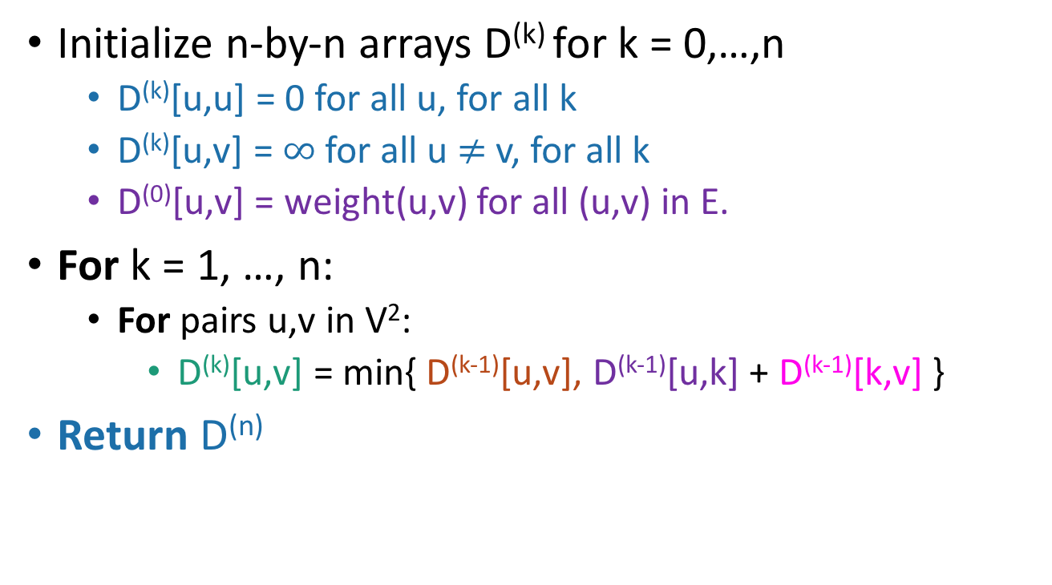
Floyd-Warshall algorithm
Initialize n-by-n arrays D^{(k)} for k = 0,…,n
D^{(k)}[u,u] = 0 for all u, for all k
D^{(k)}[u,v] = $∞$ for all u $≠$ v, for all k
D⁽⁰⁾[u,v] = weight(u,v) for all (u,v) in E.
For k = 1, …, n:
For pairs u,v in V²:
D^{(k)}[u,v] = min{ D^{(k-1)}[u,v], D^{(k-1)}[u,k] + D^{(k-1)}[k,v] }
Return D^{(n)}
The base case checks out: the only path through zero other vertices are edges directly from u to v.
This is a bottom-up Dynamic programming algorithm.

Slide 49
We’ve basically just shown
Theorem:
If there are no negative cycles in a weighted directed graph G, then the Floyd-Warshall algorithm, running on G, returns a matrix D^{(n)} so that:
D^{(n)}[u,v] = distance between u and v in G.
Running time: O(n³)
Better than running BF n times!
Not really better than running Dijkstra n times.
But it’s simpler to implement and handles negative weights.
Storage:
Enough to hold two n-by-n arrays, and the original graph.
Work out the details of the proof! (Or see Lecture Notes 12 for a few more details).
As with Bellman-Ford, we don’t really need to store all n of the D^{(k)}.

Slide 50
What if there are negative cycles?
Just like Bellman-Ford, Floyd-Warshall can detect negative cycles.
If there is a negative cycle, then there is a path from v to v that goes through all n vertices that has cost < 0.
That’s just the definition of a negative cycle.
So D^{(n)}[v,v] < 0.
So check for that; if you see it, return negative cycle.

Slide 51
What have we learned?
The Floyd-Warshall algorithm is another example of dynamic programming.
It computes All Pairs Shortest Paths in a directed weighted graph in time O(n³).

Slide 52
Recap
Two more shortest-path algorithms:
Bellman-Ford for single-source shortest path
Floyd-Warshall for all-pairs shortest path
Dynamic programming!
This is a fancy name for:
Break up an optimization problem into smaller problems
The optimal solutions to the sub-problems should be sub-solutions to the original problem.
Build the optimal solution iteratively by filling in a table of sub-solutions.
Take advantage of overlapping sub-problems!

Slide 53
Next time
More examples of dynamic programming!
We will stop bullets with our action-packed coding skills, and also maybe find longest common subsequences.

